Slide 1
Topic: Time EQ: How do I convert between Hours, Minutes, and Seconds?
Year 11 Mathematics Essentials

Slide 2
Five Questions
Topic: Time
Date: XX/XX/2021
EQ – How do I convert between hours, minutes, and seconds?
A rectangle has a perimeter of 86 metres and a length of 30 metres. How long is the width?
How many litres of water will I have to take on a camping trip to allow for 90 cups of water if my cups hold 275 mL?
My house plan has a scale of 1:50. what length would a line that is 13.5 cm long represent? Write your answer in metres and millimetres?
Convert 1.2kg into mg.
An electrician charges a call out fee of $45, plus $80 per hour. What will you pay for 3 hours of work?
Notes:
13m
24.75 L
6.75 m, 6750 mm
1.2kg = 1200g = 1 200 000 mg
$285

Slide 3
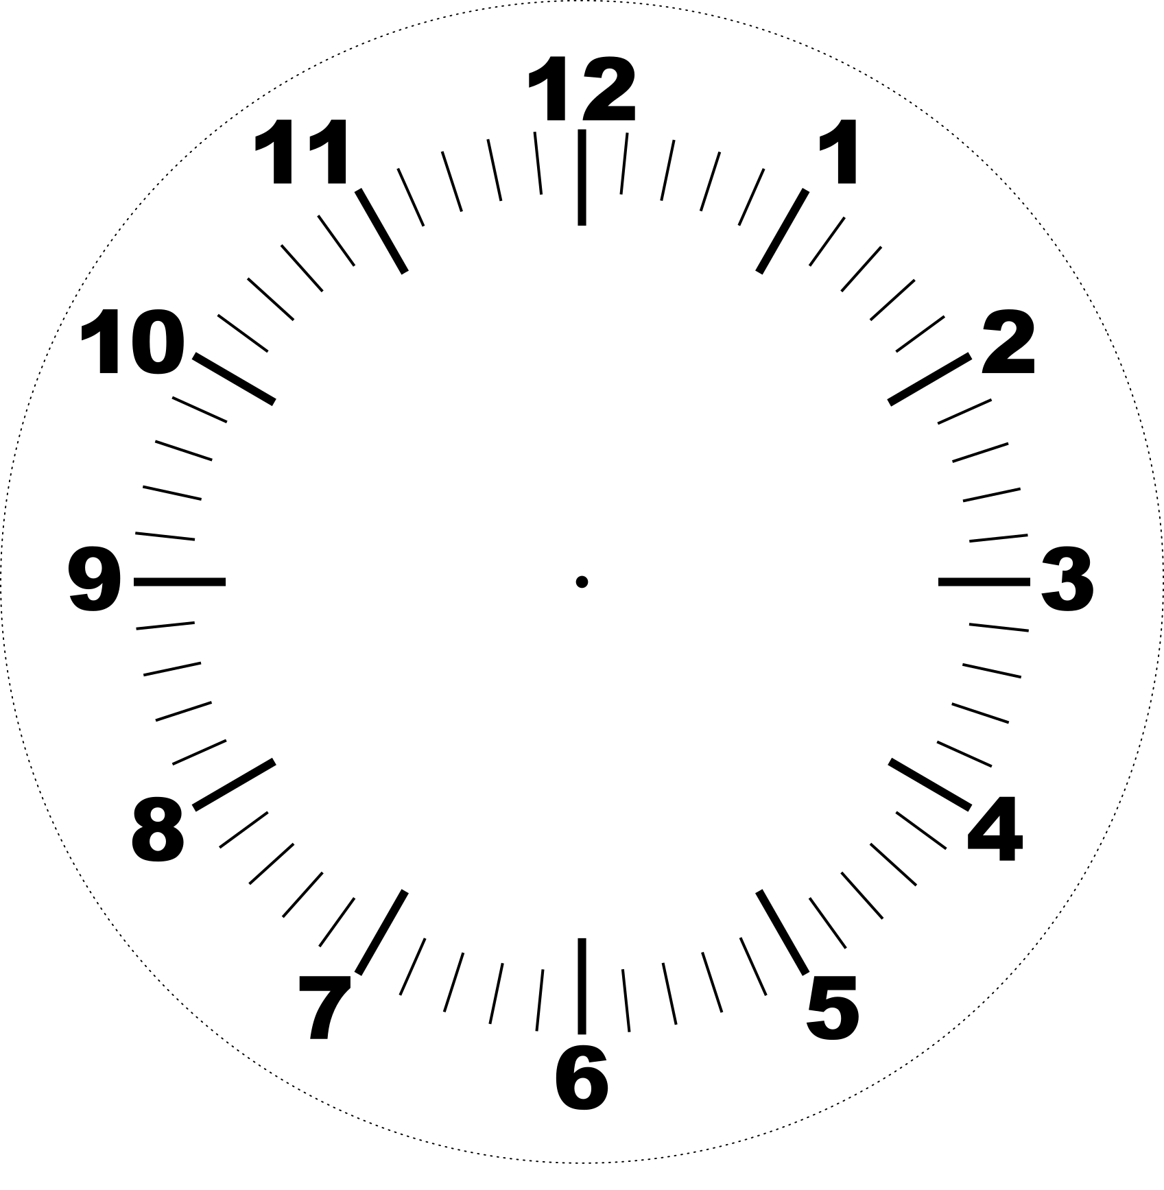
Think Pair Write Share
The hour hand takes 12 hours to go around the clock.
How long does it take for the minute hand to go around the clock?
How far does the minute hand move in:
A quarter of an hour
5 minutes
How do the marks between each number relate to the movement of the minute hand?
Notes:
Check in with students that they can read the time on an analogue clockface before going further.

Slide 4
24
7
30
Date: XX/XX/2021
Topic: Time
EQ – What are the fractions of an hour and minutes?
How do I convert between hours, minutes, and seconds?
The standard unit of time is seconds
Time Conversion Caterpillar
Hour Minutes Second
× 60
× 60
÷ 60
÷ 60
WICOR

Slide 5
24
7
30
Date: XX/XX/2021
Topic: Time
EQ – What are the fractions of an hour and minutes?
Convert the following time units to fill in the blanks in the table
Example:
Seconds | Minutes | Hours
306
 | 23
 |  | 1.5
 | 2
950
 | 209
 |  | 10
WICOR

Slide 6
TASK:
Complete the Apply questions on p.119 in the Interleaved Maths Essential Connections 11 text.

Slide 7
24
7
30
Date: XX/XX/2021
Topic: Time
EQ – What are the fractions of an hour and minutes?
Convert the following time units to fill in the blanks in the table
What is
Seconds | Minutes | Hours
306
 | 23
 |  | 1.5
 | 2
950
 | 209
 |  | 10
WICOR

Slide 8
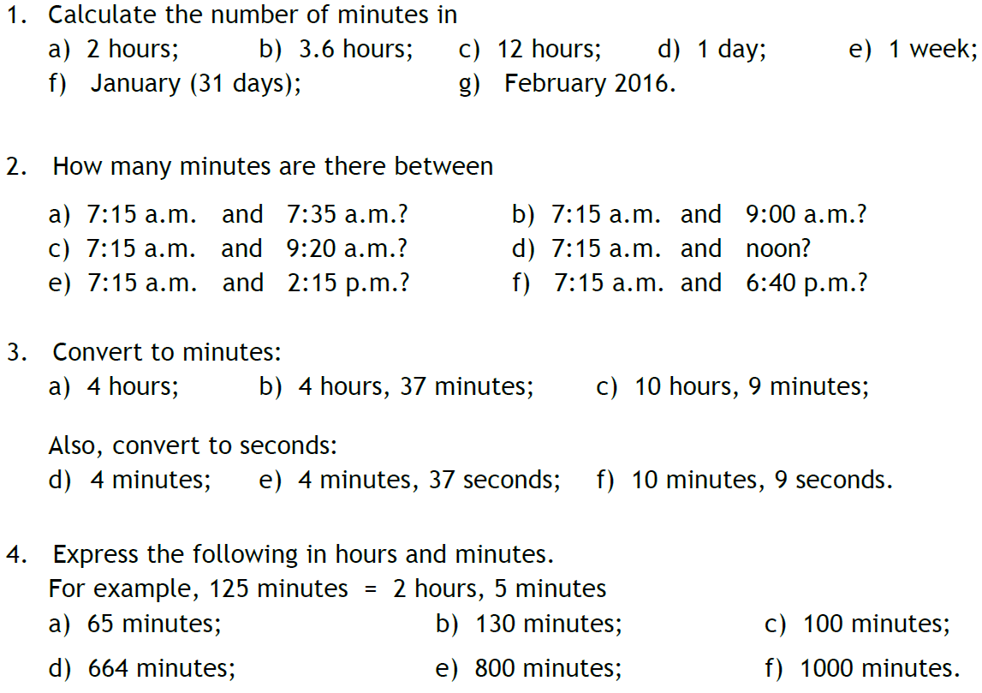

Additional Practice

